Slide 1
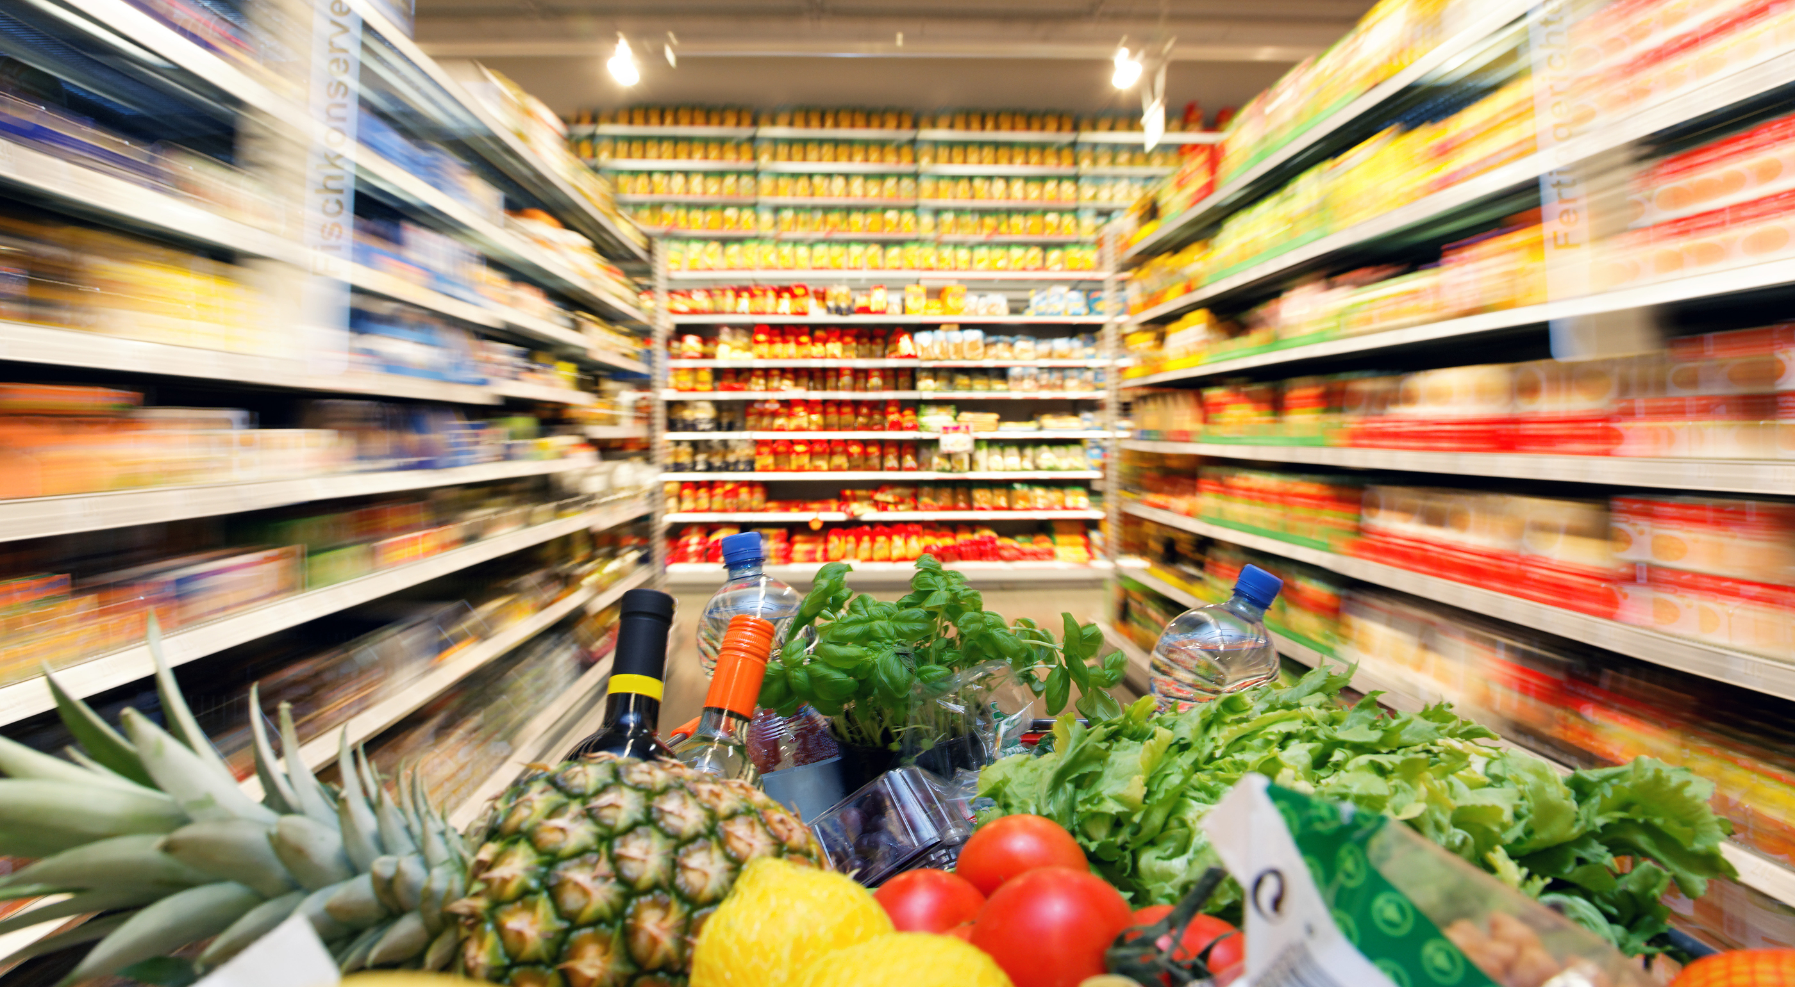

Shopping Cart
Final project - Price Compare – CodeValue
2016
Alex Kohatzki

Slide 2
What I did …
Bonus :
UI interface.
Save and Load shopping cart in external file.
Update data automatically in background, download and unzip files.
Manage users and save their shopping cart.
Export excel data file to shopping cart.

Slide 3
Overview
First reading data from ItemsList.xml
And from chain.xml.
-ItemsList.xml – manually mapped
products, in key form.
-chains.xml – contains data on chain that
will be use.
After that , bring from chain’s files
relevant products data and save it in objects.

Slide 4
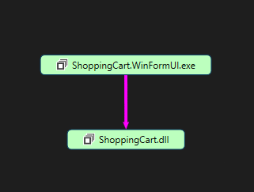
Overview
Divided to two parts :
ShoppingCart – buisness logic part.
ShoppingCart.WinFormUI – GUI part.

Slide 5
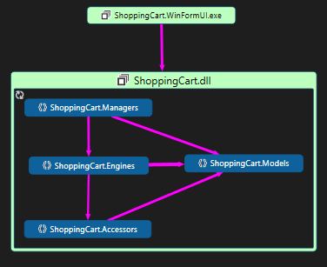
ShoppingCart
Managers – Up level , manage all , with api ,
connect to UI.
Engines – middle level , do all “dirty” work.
Accessors – connect and bring data from
outside world, xml and website.
All communication between levels is by Models.
Interfaces and EventsArgs hided from the chart.

Slide 6
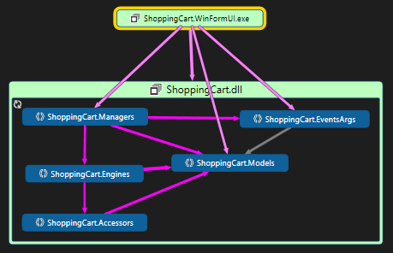
ShoppingCart.WinFormUI
UI communicate with business logic
level By Events , EventsArgs , Models ,
methods and properties.

Slide 7
I did it with…
Serialization – save and load users and shopping cart in external files (.dat)
Async/Await tasks -
update xml files in background (Download and unzip)
Save excel data files.
Events + EventsArgs – communicate with GUI.
Models – objects with information that passing over all project.

Slide 8
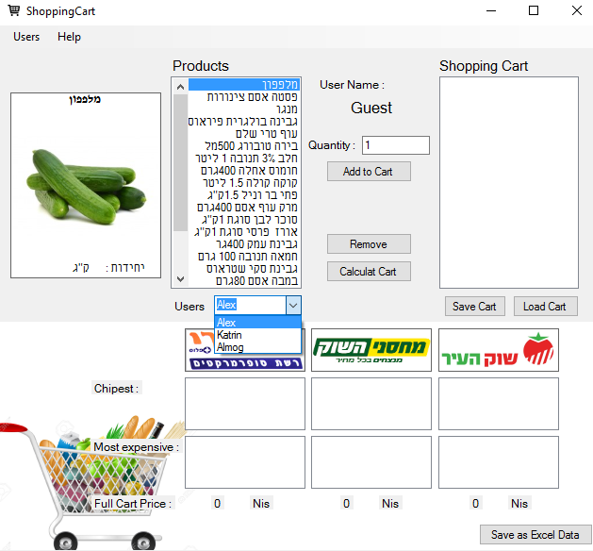
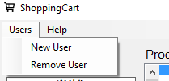
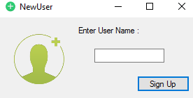
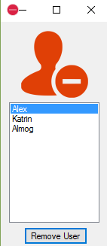
Screenshots

Slide 9
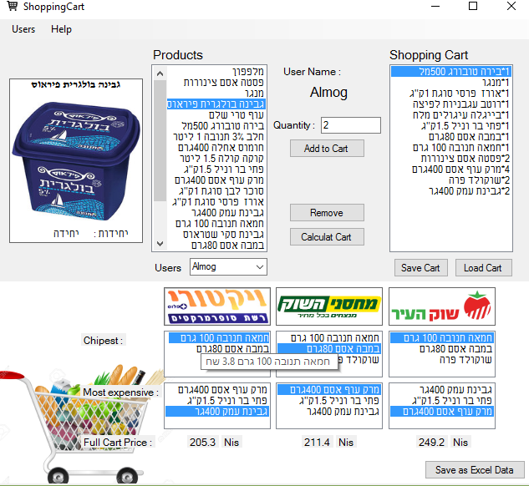
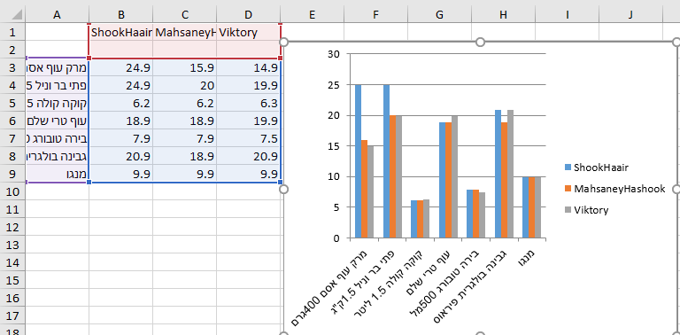
Screenshots

Slide 10

Thank you !

